Slide 1

Travel Experts
Notes:
Good Morning

Slide 2

Our team
Bilal (Software Developer)
Ivan (Software Developer)
Elias (Software Developer)

Slide 3

Deliverables
Windows Application for agents
Web Application for customers

Slide 4
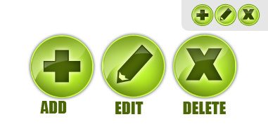
Windows application’s features
Add/Edit/Delete Travel Packages
Add/Edit Product, Suppliers

Slide 5

Web application features
Login, Registration
Update Account details
Display personal packages and price breakdown

Slide 6

Demo!

